Slide 1
Methods 2 Classroom 3

Slide 2
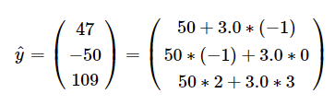
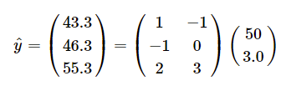
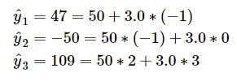
Recap
Vector and Matrix notation
Probability distributions: Normal, Binomial and Poisson distributions
Reach out if you still have GIT issues
Vector
Matrix

Slide 3

TODAY
Simulating what we learned in week 1 and 2
Clone the git repository for a template to this weeks exercises: https://classroom.github.com/a/lv7VHnb6
The exercises are:
A warm-up exercises on problematic studies from chapter 4
Optional: 4.1 and 4.2 from last week
Warm-up exercises on simple loops
Exercises from chapter 5:
5.1, 5.3, 5.4, 5.5, 5.8, 5.9
I have added hints to some of the exercises ☺

